Slide 1

KultureHire
Data Analysis Learnternship
The Career Aspirations of Gen Z
Presentation By
Krishna Babu

Slide 2



Overview
This dashboard explores the career aspirations of Gen Z across different countries, offering
valuable insights into their goals, work frustrations, aspirations job and motivations, Etc. I
worked on this real-world problem during my internship, using various data analysis tools to
create an interactive and comprehensive dashboard. This project involved cleaning and
analyzing the data, identifying trends, and offering actionable recommendations based on the
findings. The aim is to understand the diverse career aspirations of Gen Z and how they vary
globally.

Slide 3
STEPS FOLLOWED IN THE PROJECT
Data
Collection
and Survey
Data Analysis in Excel
(Using Pivot Tables)
and MySQL
1
2
3
4
5
Understand Problem
Statement
(Using 5W1 H
Framework)
Data Cleaning
and
Standardization
Dashboard
creation
and
Analysis

Slide 4
Problem
Statement
🙍Gen Z struggles to pursue desired roles,
with their aspirations often unheard by
employers.
🗃️ Employers face challenges in attracting,
retaining, and managing Gen Z individuals.
Objective
📉The objective of this analysis is to understand the career aspirations of GenZ, identify key trends and preferences, and provide actionable recommendations
for employers.

Slide 5
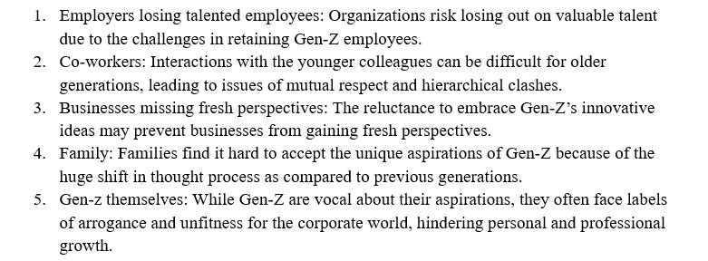
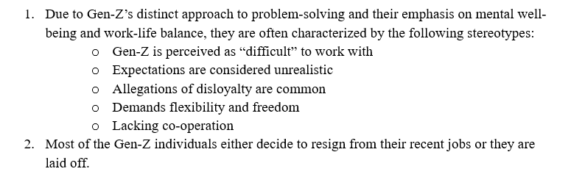
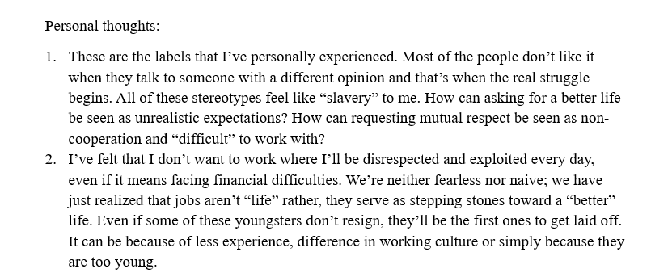
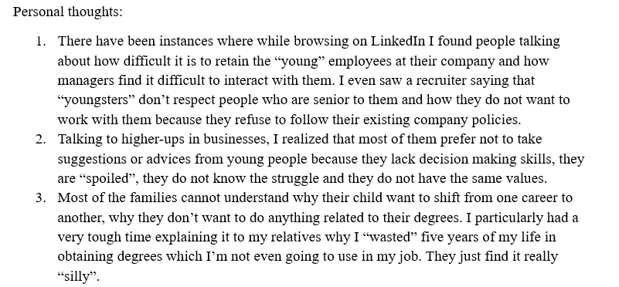
Who is affected?
What is happening?

Slide 6
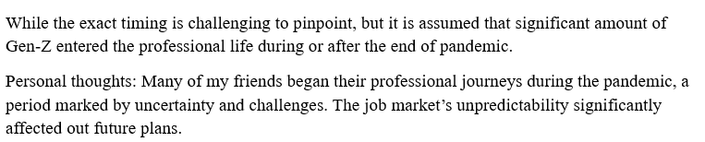
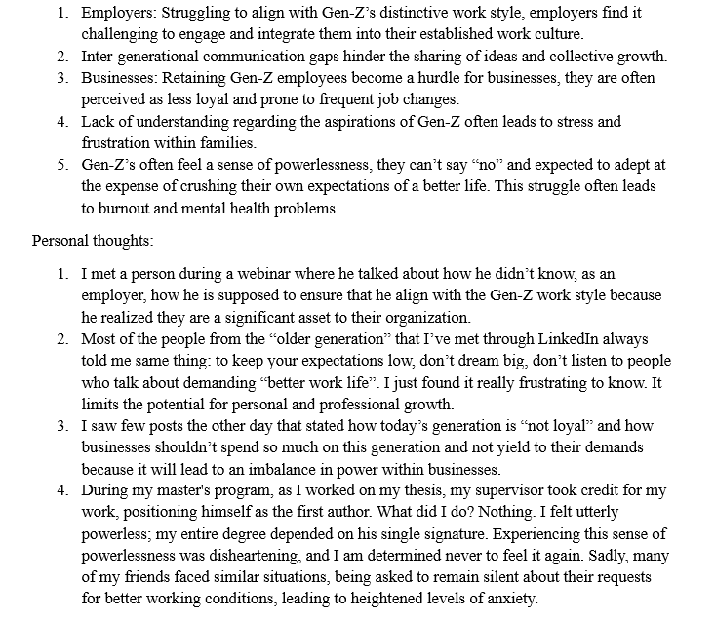
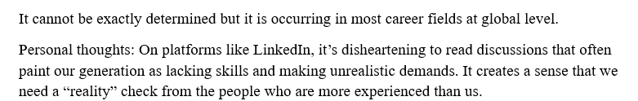
When is this happening?
Why is that happening?
Where is this happening?

Slide 7
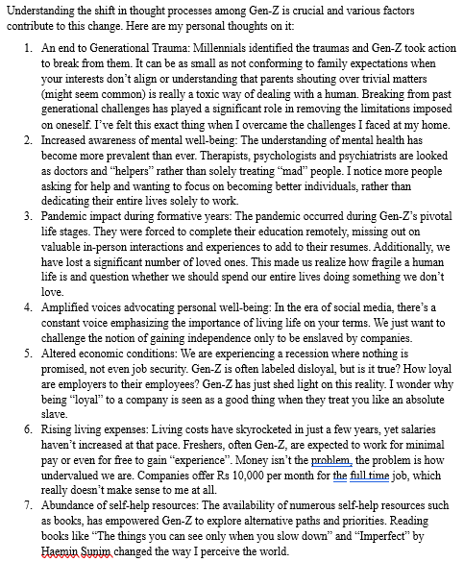
Personal thoughts on various factors contributing to this change in Gen Z
References
Authentically Gen Z: The Values, Aspirations & Drivers That Will Re-Define the Future of Work
Gen Z: The workers who want it all
Sentiments of Indian Gen Z workforce in 2023: Part I
Gen-Z Is Labeled As ‘Difficult’ In The Workplace, But There’s More To The Story
How does Gen Z see its place in the working world? With trepidation
Why Gen Z workers are already so burned out
Aspirations & Wants of Generation Z - A Study on the Work Force of the Future

Slide 8
Data Survey
📰 Created a Google survey form to collect data and distributed the link across various platforms to gather responses.
Tools and
Technologies
Used
🛠️The dashboard was developed using Microsoft Excel.
🧹Data was cleaned and standardized using Excel.
📊 Analyzed using Pivot Tables.
🗃️SQL was used for data extraction and analysis.

Slide 9
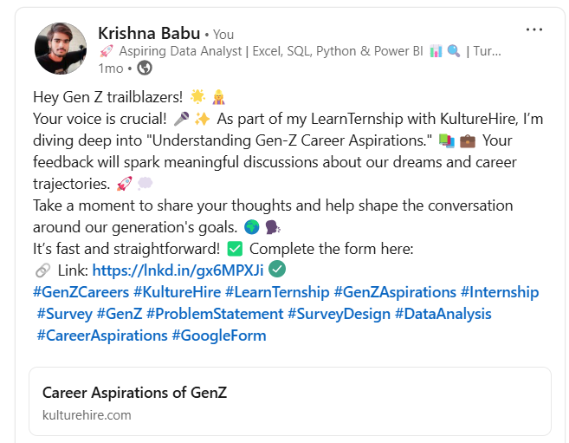
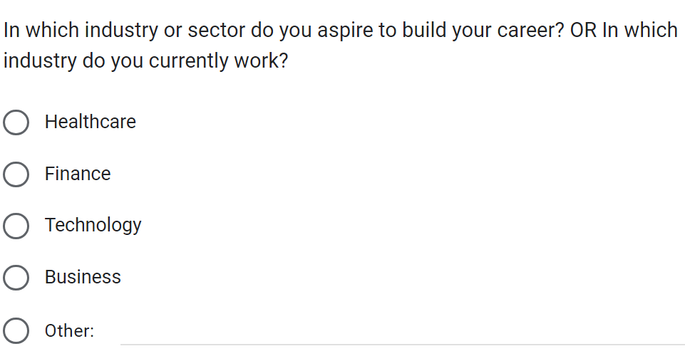
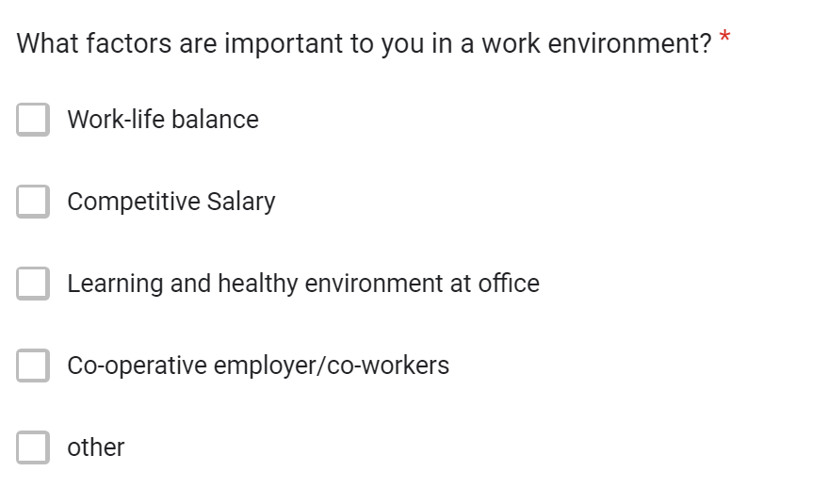
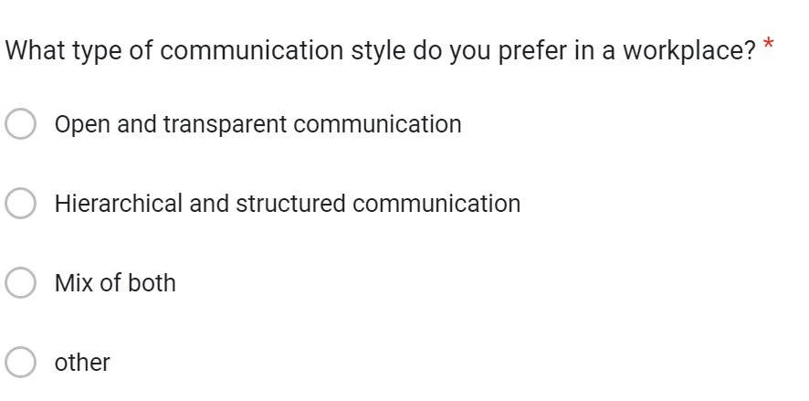

Slide 10
CLEANING & STANDARDIZING IN SQL

Slide 11
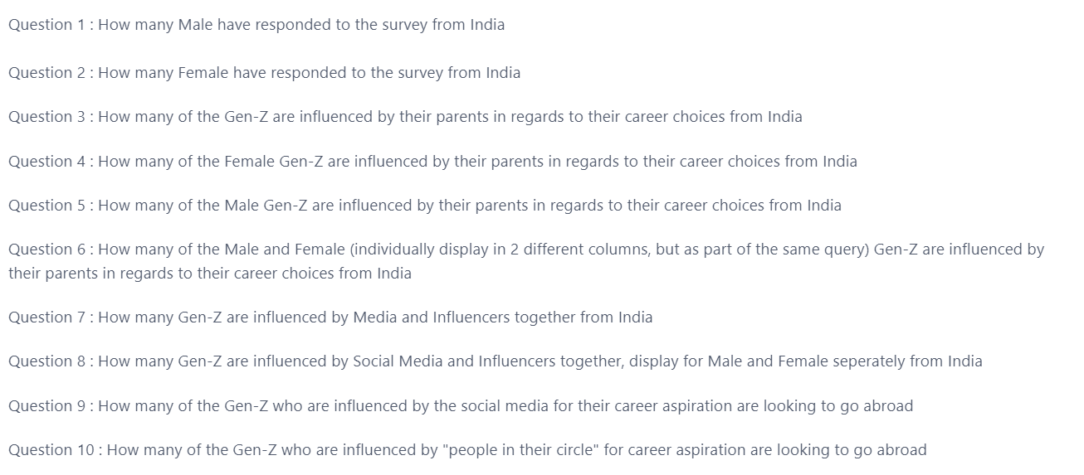

Slide 12
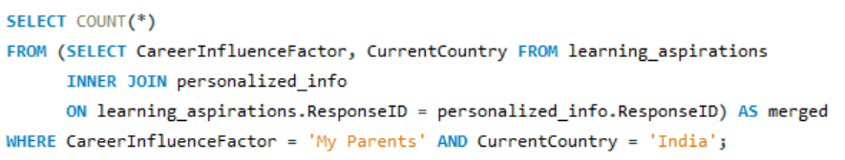
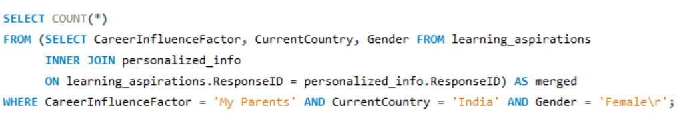
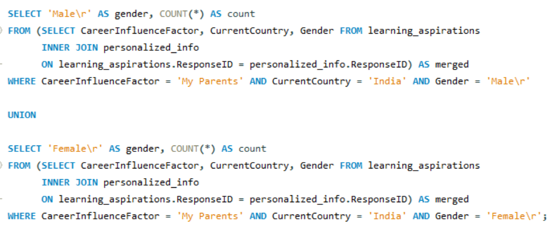
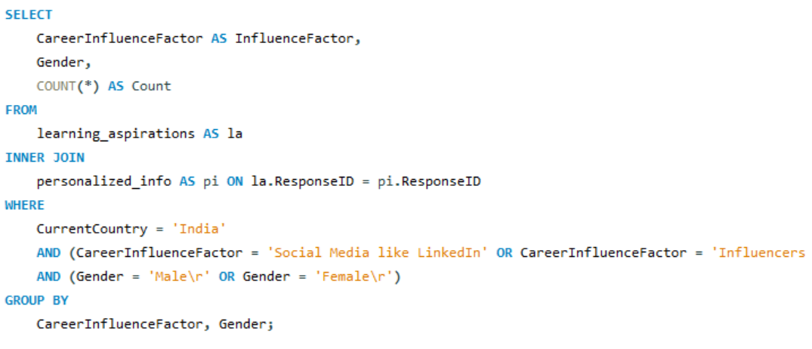

Slide 13
ANALYZING
IN SQL

Slide 14
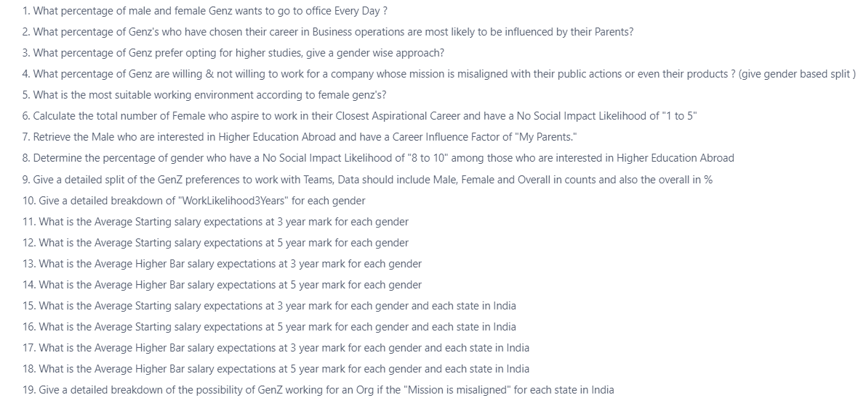

Slide 15
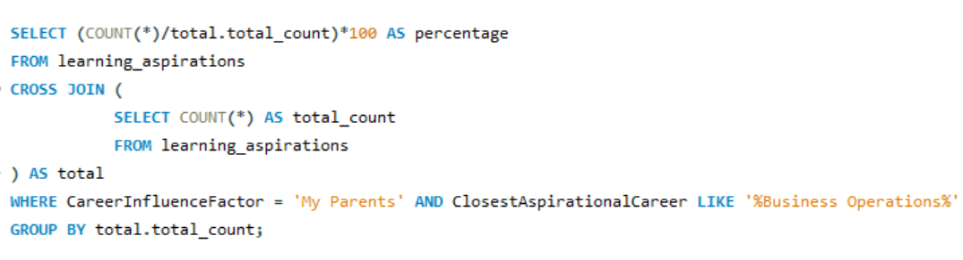
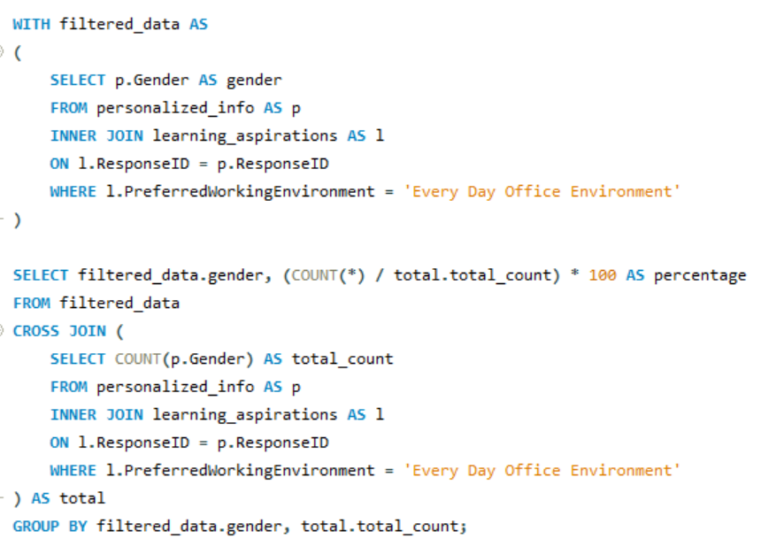
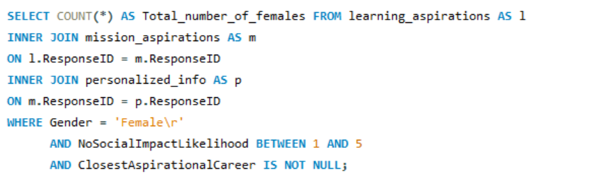

Slide 16
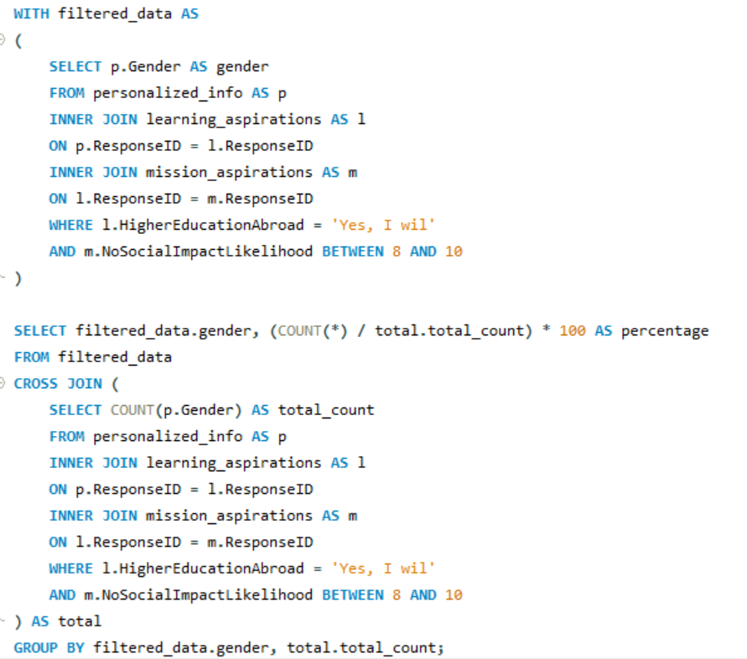
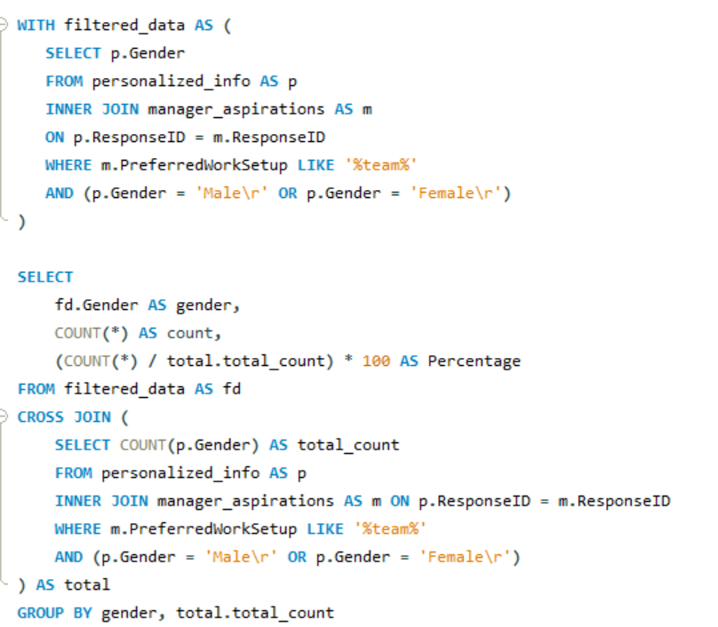
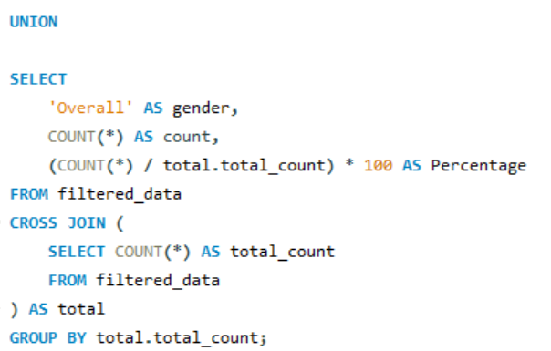

Slide 17
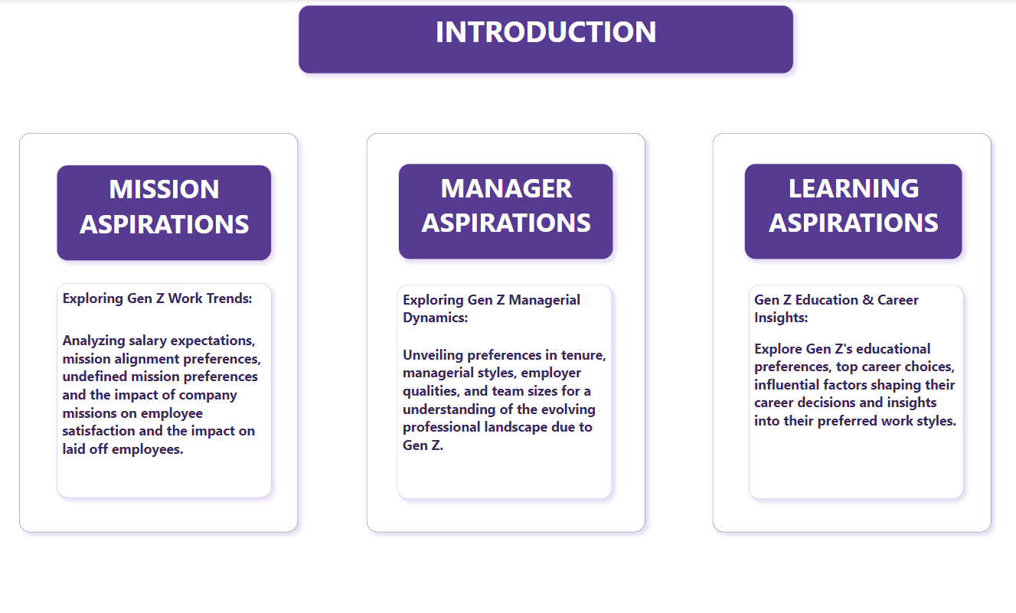

Slide 18
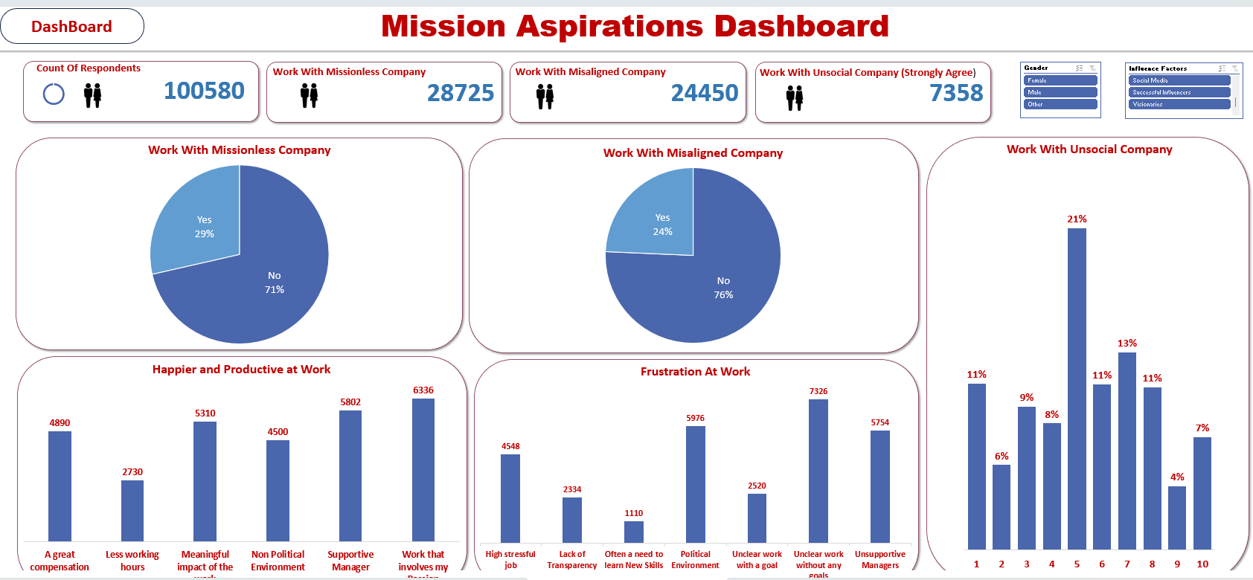
Dashboard Overview

Slide 19
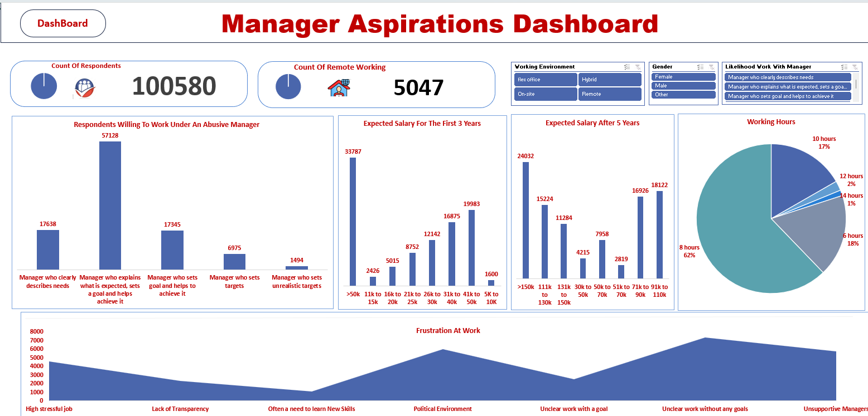

Slide 20
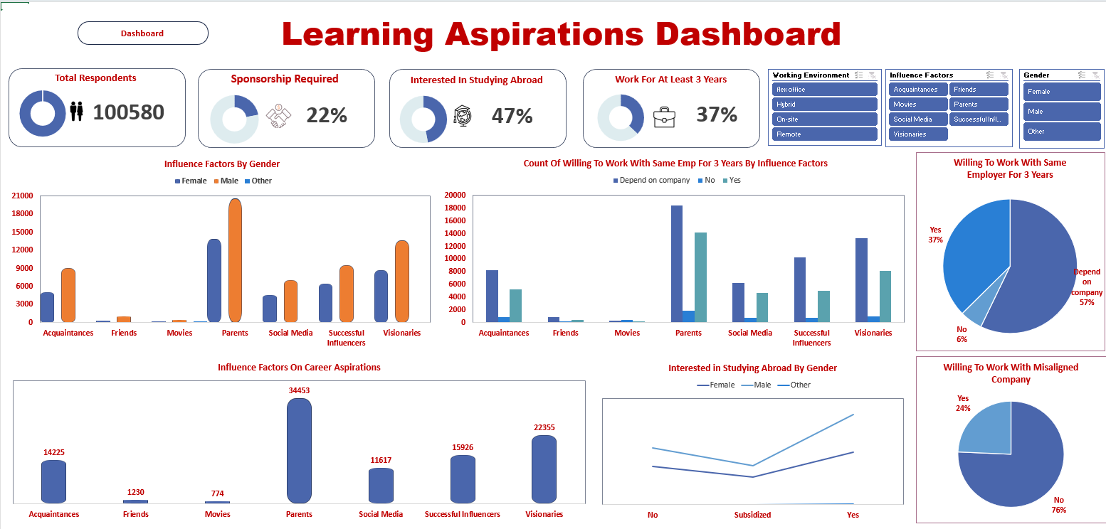

Slide 21
🗝️Key Insights
🏫 Higher Education Aspirations:
- 47% (47,187 out of 100,580) of Ge Z plan to pursue higher educational road.
🔝 Top 5 Preferred Company Types:
1) Mid-Size Companies (251 to 1,000 Employees)
2) Corporations (3,000+ Employees)
3) Startups (51 to 250 Employees)
4) Large Companies (1,001 to 3,000 Employee
5) Startups (Fewer than 50 Employees)
🚨Key Observations:
1. Most Gen Z prefer to work in mid-size companies.
2. The least number of Gen Z prefer to work in startups.
3. Males are less likely to prefer working in large companies cornpared to females.

Slide 22
🗃️ 68% of males, 77% of females, and 34% of other gender categories prefer to
work in companies with a clear mission, indicating higher awareness among the female gender category.
84,039 Ge Zs prefer to workin teams of 2 to 3 people.
- The highest expected monthly salary after 3 years is greater than 50K.
- The lowest expectedmonthly salary after 3 years is between 5K and 10K.
The most common work frustration is 'Unclear work without any goals’.
👧Female and Other Gender: 'Political Environment’
👨Male: 'Unclear work without any goals'

Slide 23
Top 5 influences on career aspirations:
1) Parents
2) Visionaries
3) Successful Influencers
4) Acquaintances
5) Social Media
- Gender-wise influences on career aspirations:
Male and Female: Parents
Other: Movies

Slide 24
Recommendations Based on Analysis
🎯Target Mid-Size Companies
Companies should focus on positioning themselves as attractive workplaces for Gen Z by highlighting their advantages, such as growth opportunities, community culture, and flexibility.
🎯Mission Clarity
Companies should clearly communicate their mission and values to attract a diverse workforce.
Highlight these in:
1. Your website
2. Job postings
3. Recruitment materials"

Slide 25
Address Work Frustrations
Organizations should develop clear goal-setting frameworks and minimize
political environments to reduce common work frustrations.
Implementation:
- Introduce regular goal-setting and performance review sessions where
employees set and review clear, achievable goals.
- Offer training for managers on effective goal-setting and leadership skills.
- Create anonymous feedback mechanisms for employees to report political
issues.

Slide 26
🎯 Team Dynamics
- Since most Gen Zs prefer small teams, companies should create
team structures that support this preference.
Implementation:
- Organize work projects around small teams of 2-3 people.
- Promote team-building activities.
📶 Influence of Parents and Media
Career counseling programs should involve parents and leverage
media influences to align with Gen Z's career aspirations.
💵 Salaries
Review and adjust salary structures to meet Gen Z's expectations
to attract and retain Gen Z talent.

Slide 27
Challenges and Solutions
Challenges: Data cleaning and standardizing.
Solutions:
Used Power Query and functions.
Replaced missing values with 'NULL' / 'NA'/O.
Changed data types if necessary.
Removed duplicate values and unwanted spaces.
Renamed columns (e.g., "Which of the below factors influence the
most about your career aspirations?" to "Influence Factors").
Extracted and formatted data using Power Query.
Split columns by delimiter and used advanced options to split into rows.
Standardized data (e.g., Female to F, Male to M).

Slide 28
Conclusion
• The Gen Z Career Aspirations Dashboard shows what Gen Z wants and
the problems they face in their careers.
• Gen Z prefers clear job roles, likes working in mid-size companies, and
is influenced by parents and media.
• By understanding and meeting Gen Z's career needs, companies can
better attract, keep, and manage this generation, leading to success for
both sides.

Slide 29
THANK YOU!!

